Slide 1
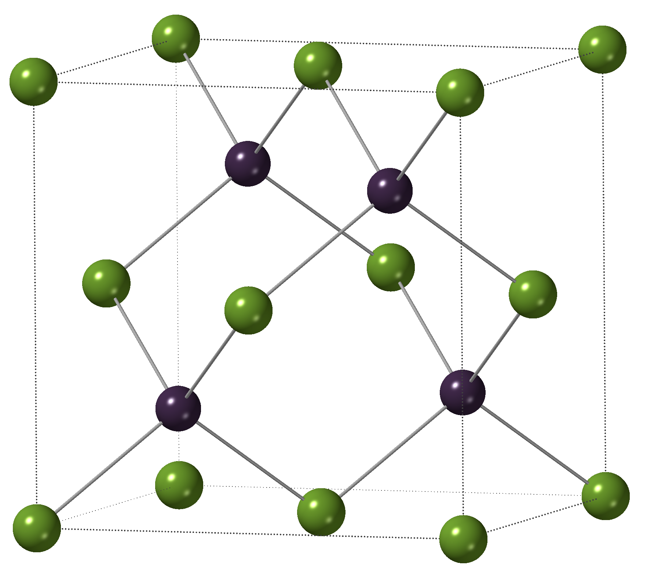
Bands & PDOS

